Slide 1
RESTAURANT MANAGEMENT SYSTEM
Prepared by
Srimathy Kumar
Guided by
Junie

Slide 2
INTRODUCTION
I want to make this project for the purpose of making a restaurant management system easier. We know that managing a restaurant in old tradition is very costly and time consuming. To make the overall system efficient we want to make this management system. Here we want to serve our customer getting very efficient management system which will provide all kind of management like as workforce management and inventory control, etc.

Slide 3
FEATURES
On Place Features: Add, delete, update food items, items price (CRUD operations).
Online Features: Place food order for both on place and home delivery.

Slide 4
ADVANTAGES
Decreased Workload
Save Time
User friendly - Customer can order food easily
Admin can add, delete, update the food details
Database Connectivity- Customer details and food details
Accessible in all kinds of screen size with help of responsive website

Slide 5
SYSTEM REQUIREMENTS
HARDWARE REQUIREMENTS
SOFTWARE REQUIREMENTS
Processor : Intel core i5 or i7.
Hard Disk : 10 GB.
Ram : 8Gb.
Compact Disk : 650 Mb.
Input device : Standard Keyboard and Mouse.
Output device : High Resolution Monitor.
Operating System : Windows Family, Linux, Mac.
Application : Eclipse (JDK 19), Apache Tomcat, SQLyog
Databases : MySQL 8
Front End : HTML5, CSS3, Boostrap 5.2, JavaScript
Back End: : Java, JSP, Servlet.

Slide 6
MODULES
Items (Food)
Customer
Admin

Slide 7
ITEMS (FOOD)
Id
itemName
Price
ADMIN
Allow admin to perform CRUD (create, retrieve, update and delete) operations on Menu Items

Slide 8
CUSTOMER
Allow Customers to scroll through the menu and select the dishes he/she wants.
Allow the Customers to edit the order any time before its prepared
Allow Customers to Sign up/Sign in to proceed further.

Slide 9
FUNCTIONALITY OF MODULES
SignUp – used for Customer alone, Admin has inbuilt username and password for security purpose
Login – used for for Customer and Admin separately
Logout – used for both Customer and Admin separately
Items – helps in selecting the food items
Menu Management – insert, delete, update in food id, name and price and also stored in database
Dashboard – Admin dashboard related all Food details and food listing from database

Slide 10
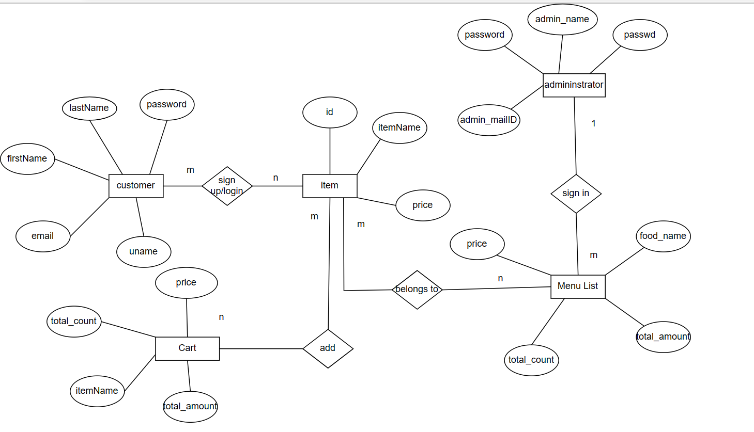
E-R DIAGRAM

Slide 11
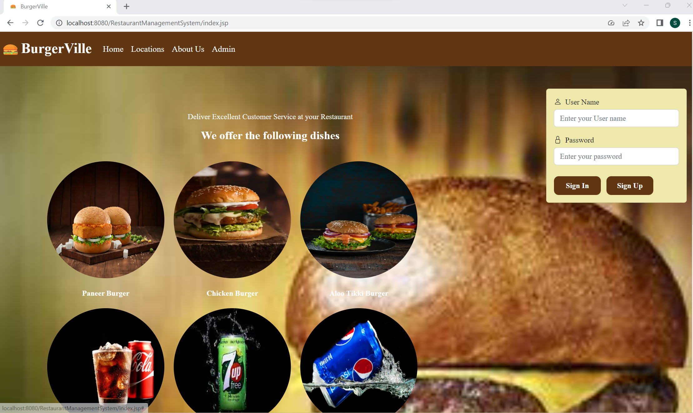
HOME PAGE

Slide 12
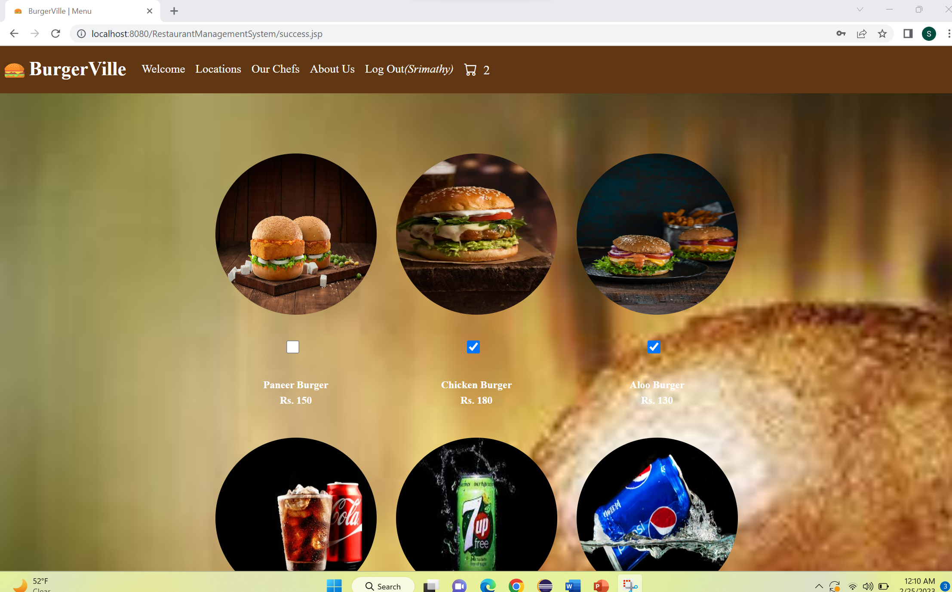
FOOD ITEMS IN MENU

Slide 13
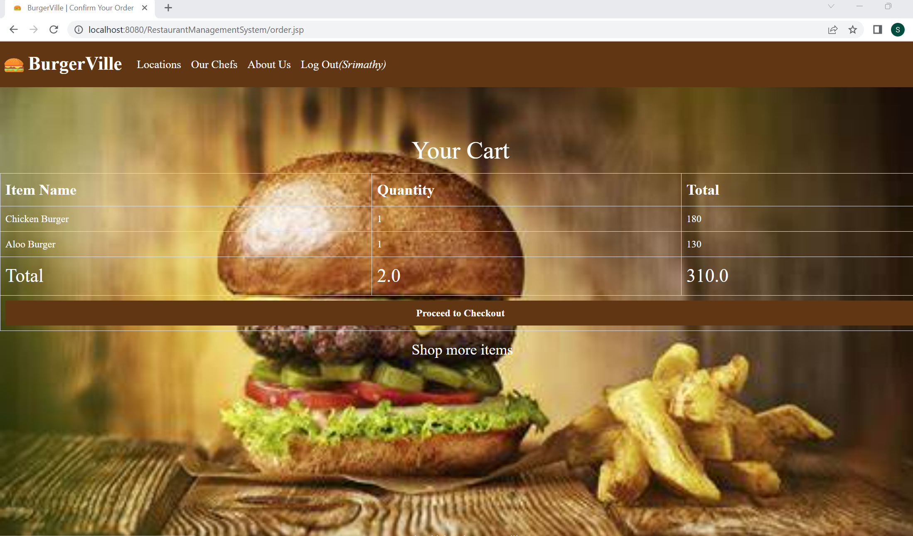
CART PAGE

Slide 14
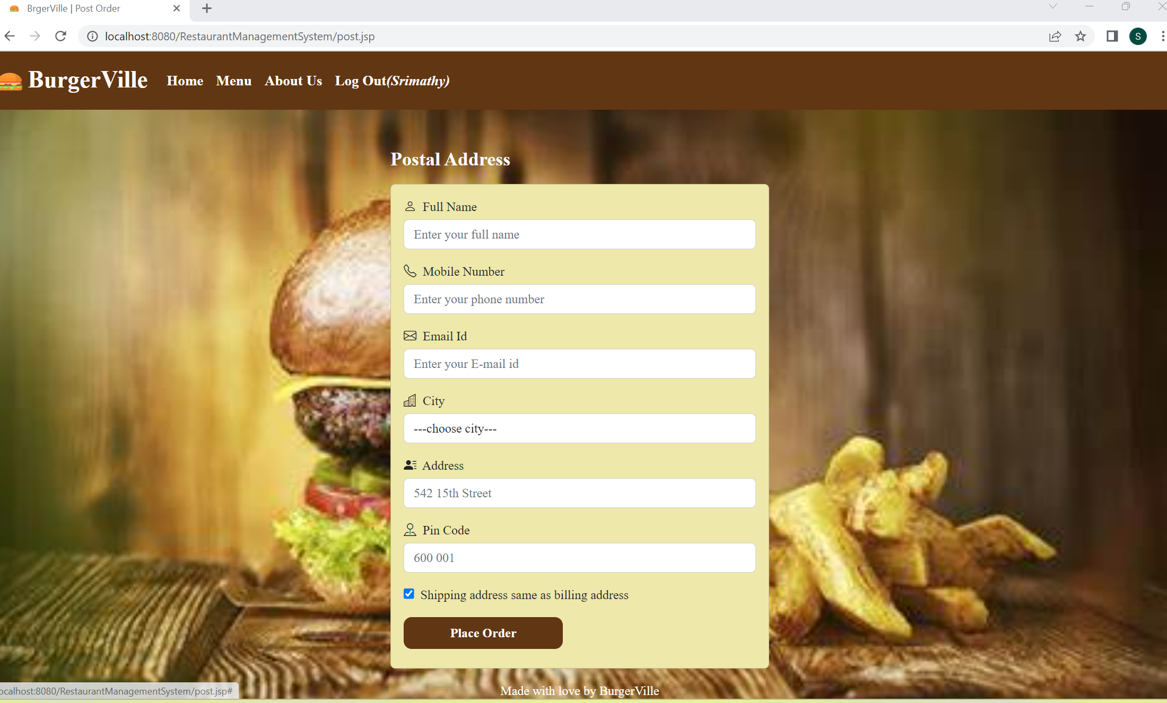
POSTAL ADDRESS

Slide 15
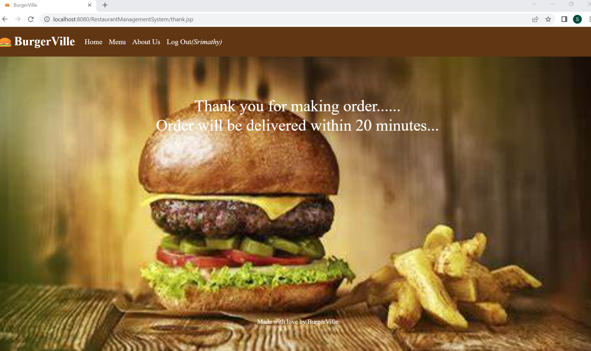
THANK YOU PAGE

Slide 16
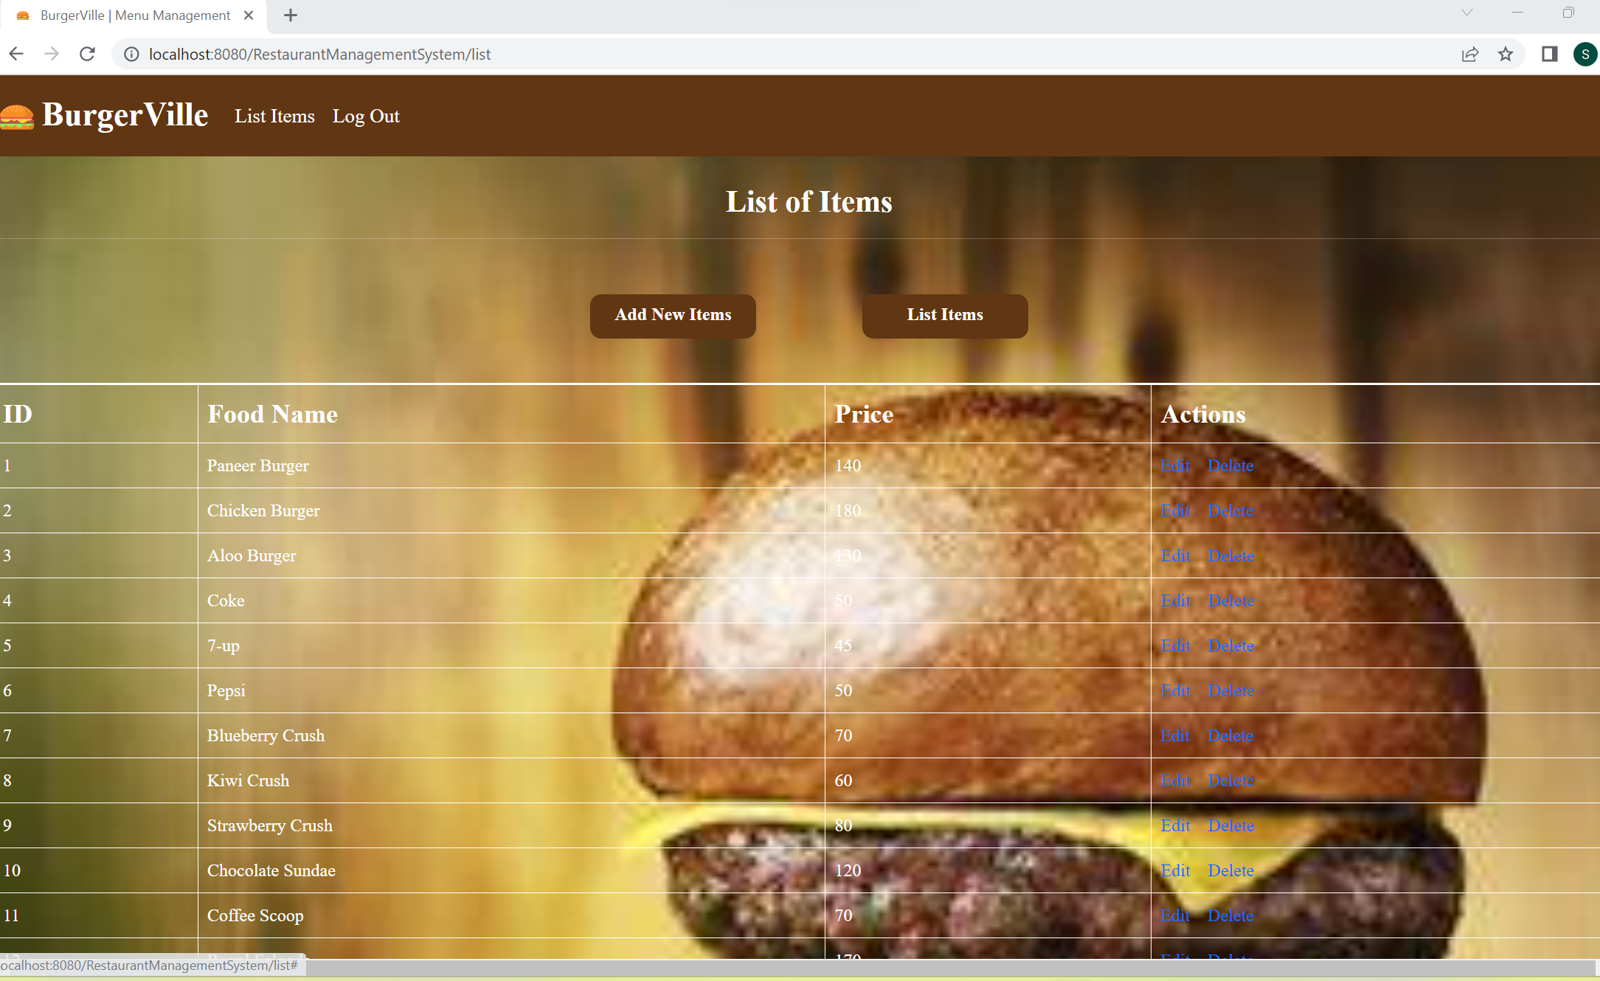
ADMIN – MENU LIST

Slide 17
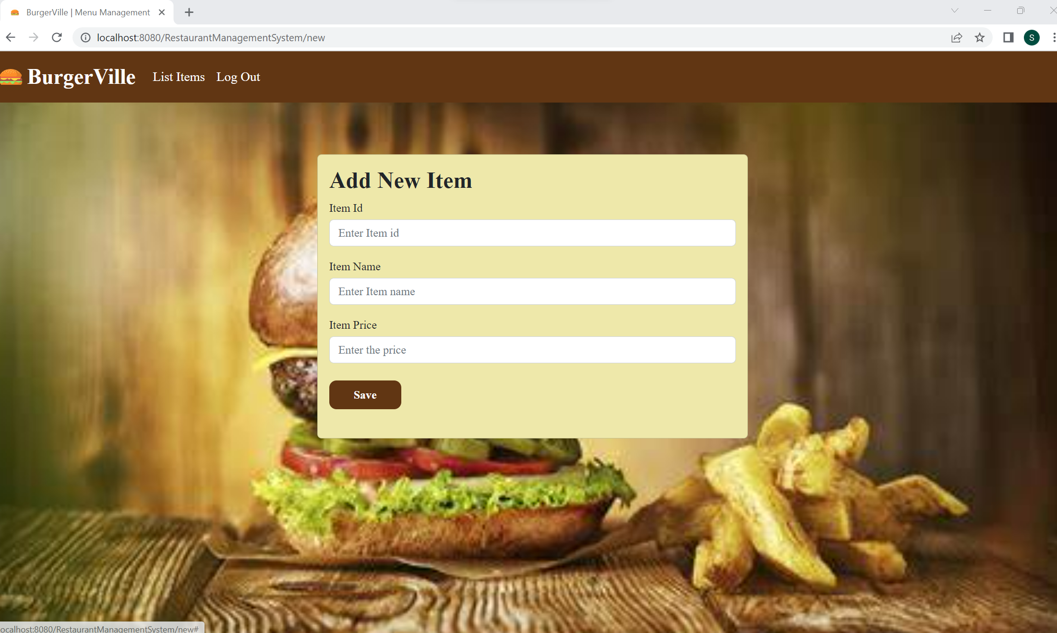
ADMIN CONTROL – ADD NEW ITEMS

Slide 18
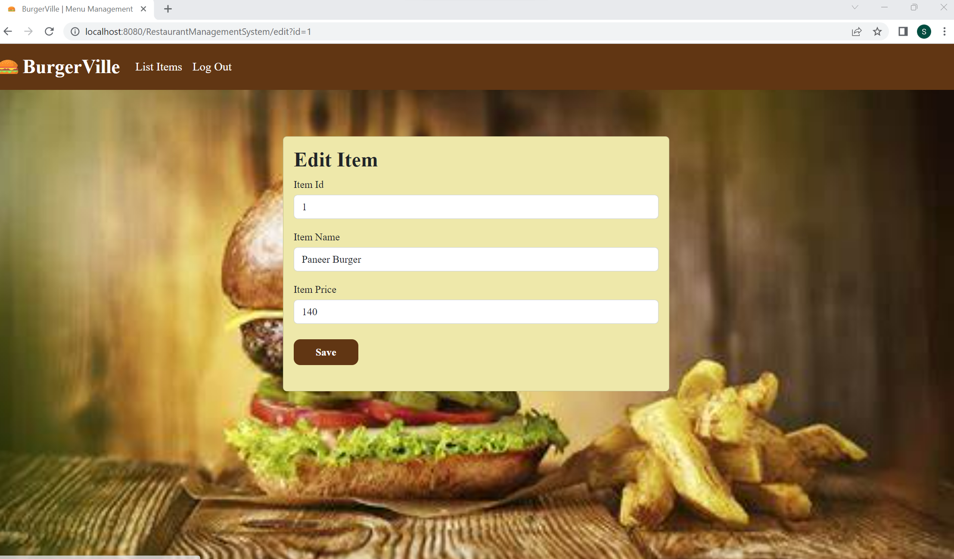
ADMIN CONTROL – ITEM

Slide 19
CONCLUSION
A competent restaurant management system web project may make or break the success of the establishment. While there are numerous aspects to consider, it is worthwhile to spend time determining how the system should benefit of the company and what I hope to achieve from it.

Slide 20
FUTURE PLANS
In future, I would like solve all draw backs and I want to add some features like storing customer details along with order details for admin and customer view, uploading the images along with food item entry. Also I will try to add payment options, Locations, Chef details and discount facilities.

Slide 21
THANK YOU…….

